Slide 1

January 6, 2016
The 4 Rules of Simple Design
Applied to complex software
Notes:
Headline: Georgia, 47pt
Subhead: Georgia, 32pt
Right Aligned
Note: Feel free to adjust sizing to fit
Note: Delete “Confidential” if not needed

Slide 2

This is how we roll
Notes:
- Ruby/Rails
- Pair Programming
- TDD
- Remote Development

Slide 3
Complex Products != Complex Designs
“
Simple software design enables simple humans to maintain immensely complex systems.

Slide 4
What are the 4 rules?
Tests Pass
Expresses Intent
No Duplication (DRY)
Small
Understanding the 4 Rules of Simple Design – Corey Haines

Slide 5
It’s about humans
Tests Pass (gives me confidence)
Expresses Intent (informs me)
No Duplication (avoids confusion)
Small (fits in my head)
Beware of geniuses

Slide 6
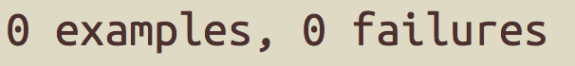
TESTS PASS

Slide 7
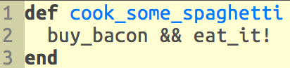
EXPRESSES INTENT

Slide 8
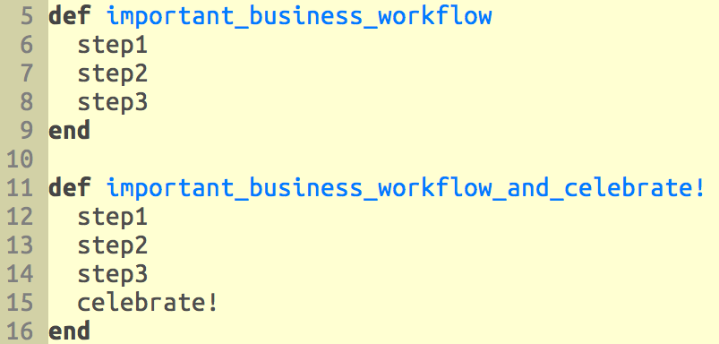
No Duplication (DRY)

Slide 9
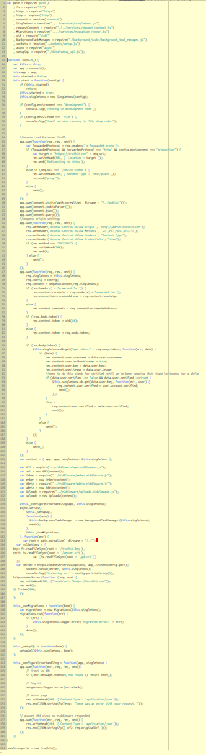
SMALL

Slide 10

Building a Complex Product
Day 1

Slide 11
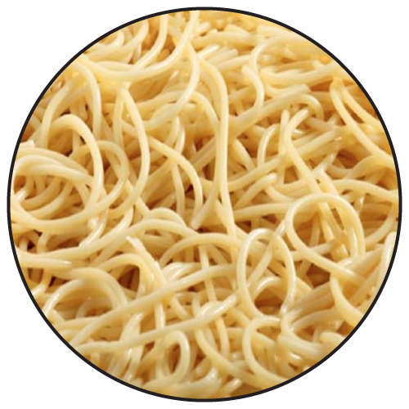
Building a Complex Product
Is this Your Future?

Slide 12
Applying the Rules
Breaking down our spaghetti problem into smaller spaghetti problems.
Notes:
––

Slide 13
Apply the Rules
Organization
Systems
Code

Slide 14
Applying the Rules - Organization

Slide 15
Applying the Rules - Systems

Slide 16
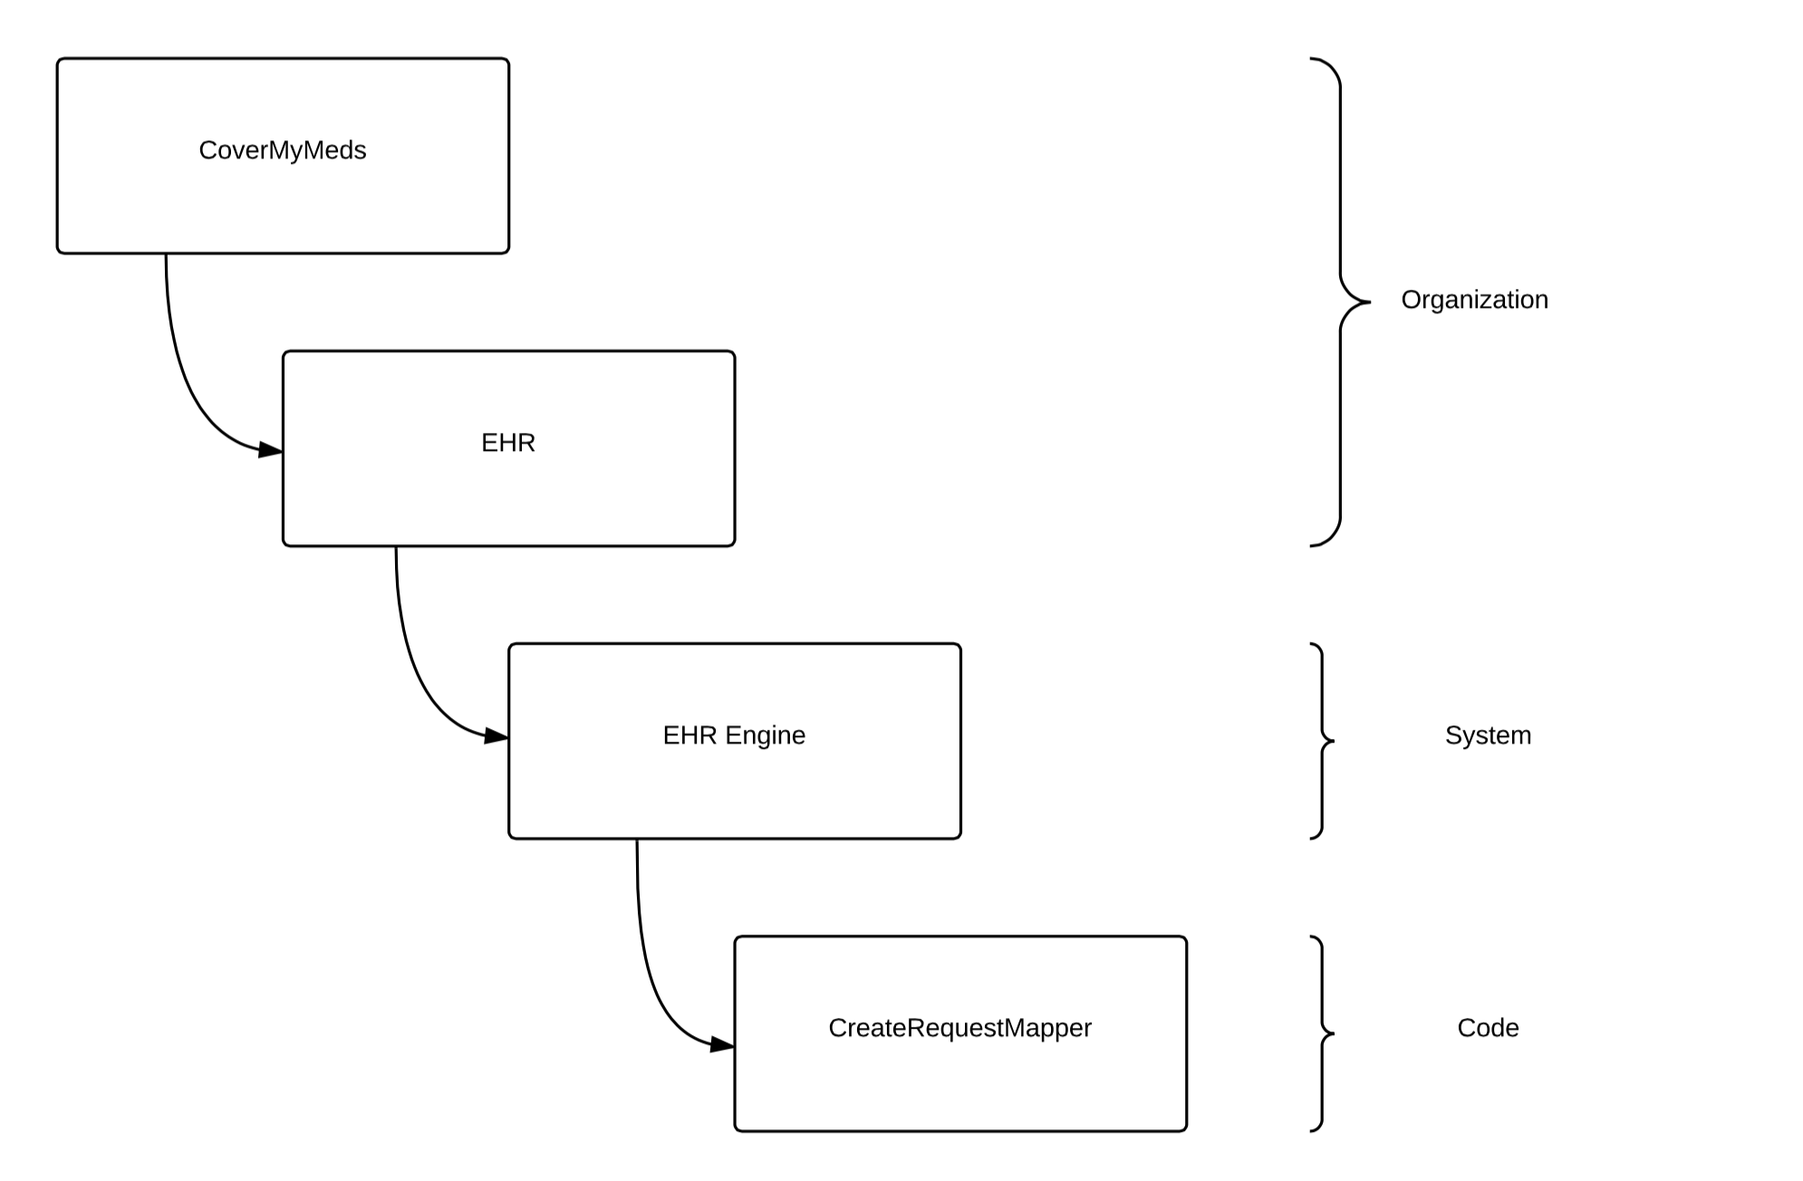
Applying the Rules - Code
Notes:
––

Slide 17
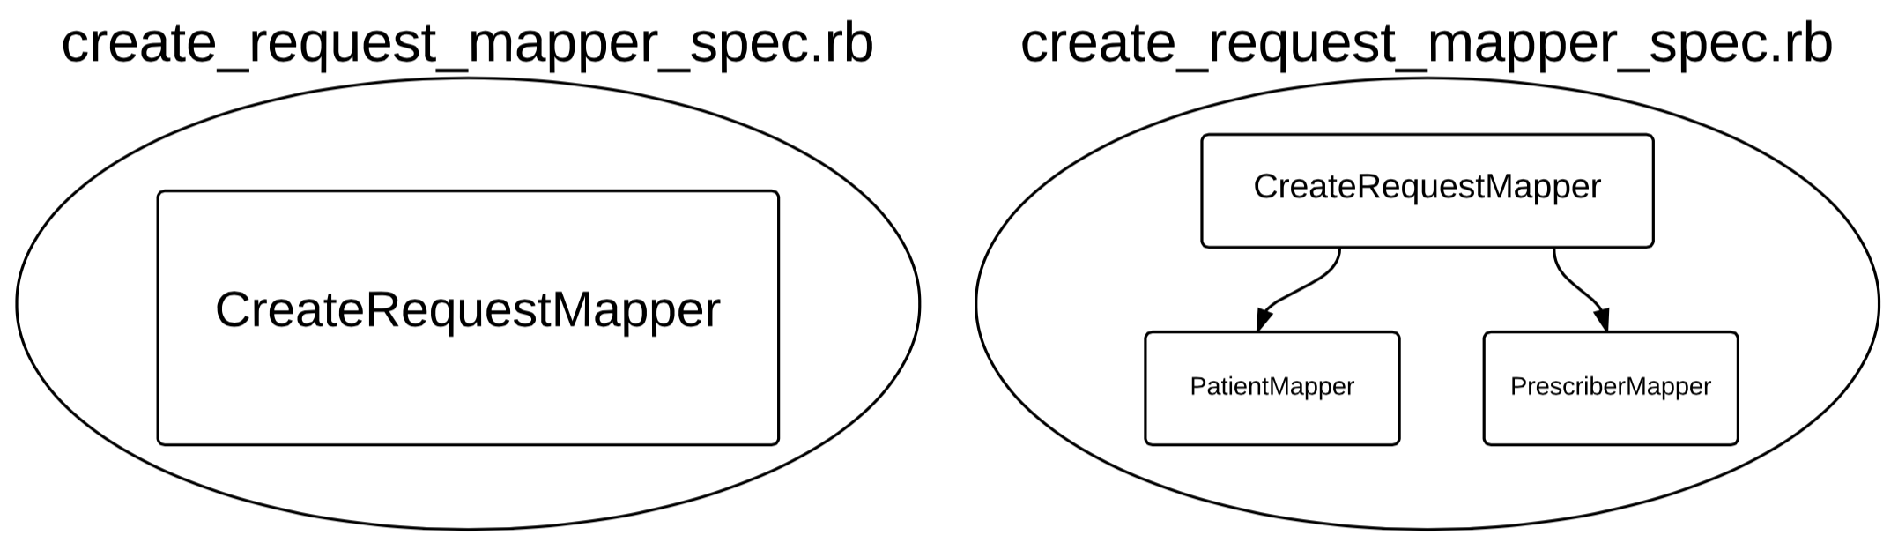
Applying the Rules – Passes Tests
Notes:
––

Slide 18
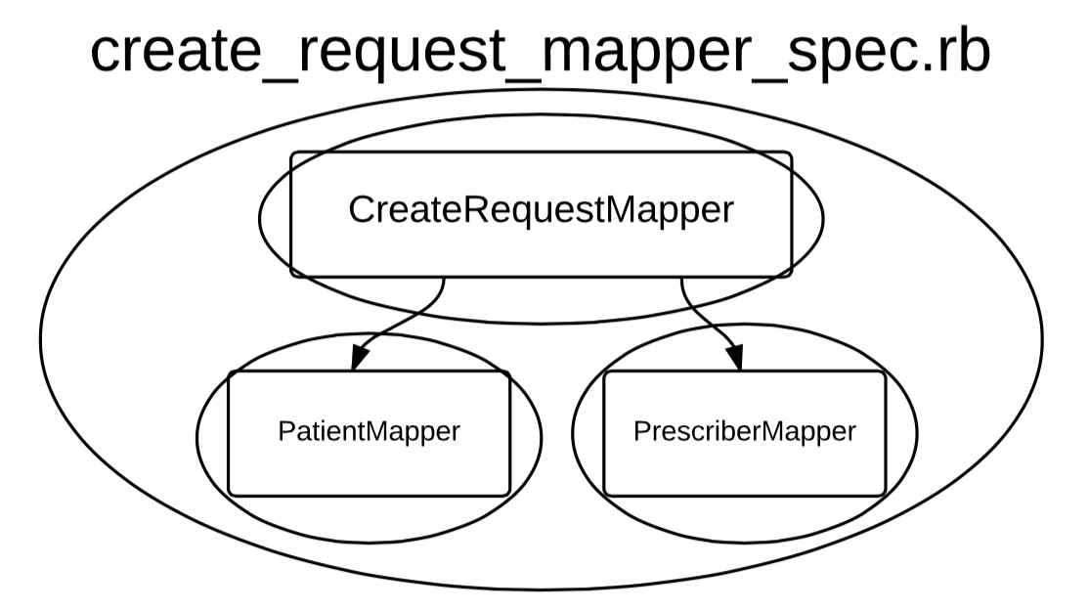
Applying the Rules – Passes Tests
Chasing the Implementation
Notes:
––

Slide 19
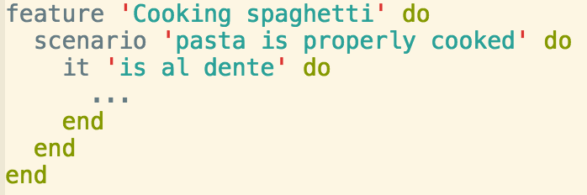
What does that even mean?
Applying the Rules – Passes Tests
Think about tests in advance and use them to help define ‘done’

Slide 20
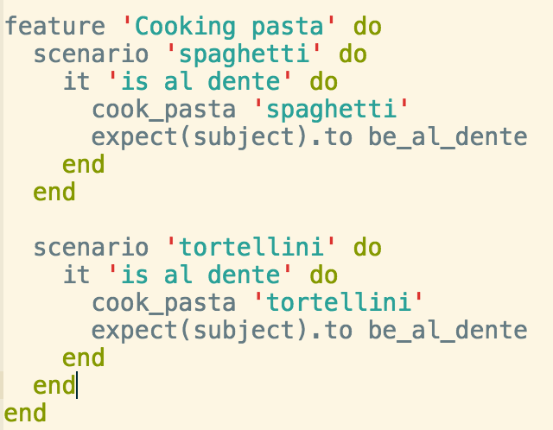
What does that even mean?
Applying the Rules – Passes Tests
Make your tests as adaptable as your code

Slide 21
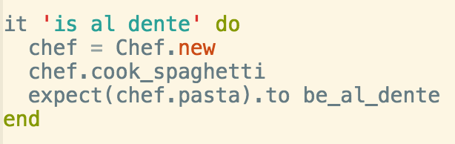
What does that even mean?
Applying the Rules – Passes Tests
Make your tests readable so you know you are testing the right things!

Slide 22
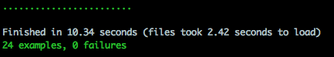
What does that even mean?
Applying the Rules – Passes Tests
Provide security to Future Developers
If you are a Future Developer, don’t break anything!

Slide 23
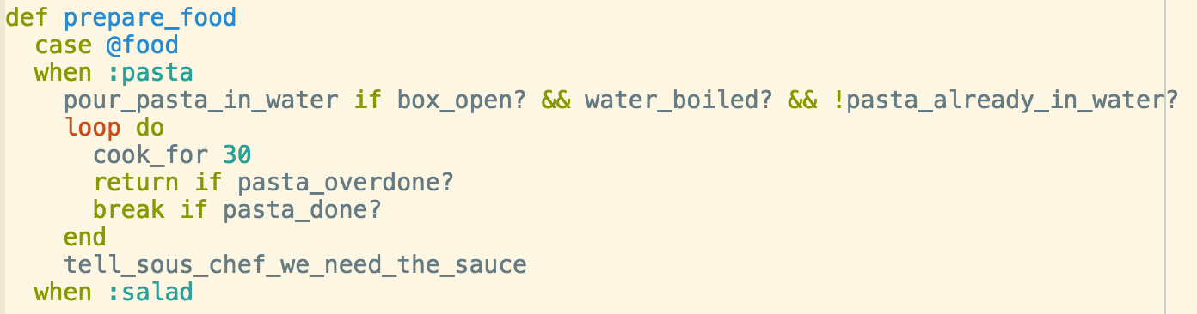
What does that even mean?
Applying the Rules – Passes Tests
If it’s hard to test, you built it wrong!

Slide 24
You don’t have to TDD, but it helps!
Applying the Rules – Passes Tests

Slide 25
Unit tests…
Applying the Rules – Passes Tests
Provide security to future developers
Help you understand what you are building
Help you make better design decisions while building

Slide 26
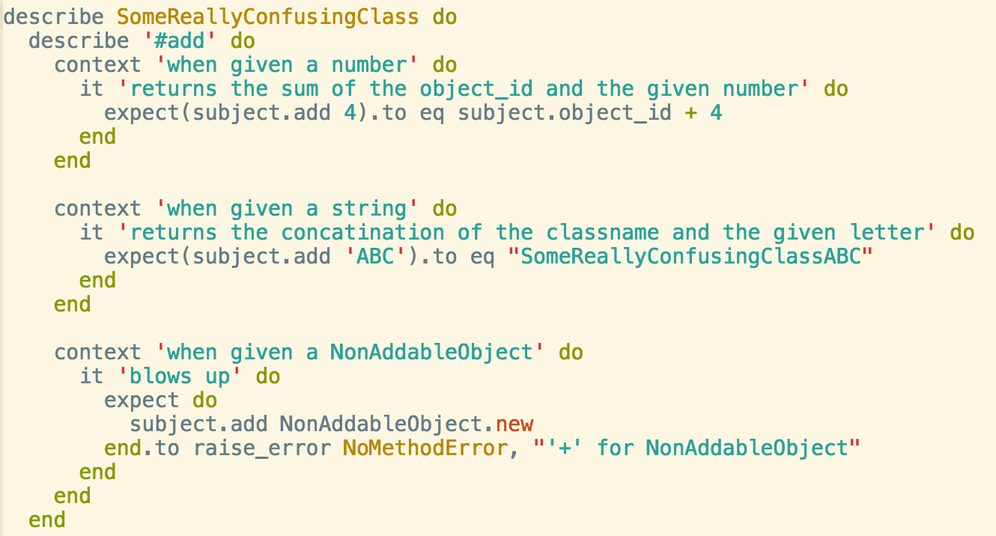
Unit tests…
Applying the Rules – Passes Tests

Slide 27
Function tests…
Applying the Rules – Passes Tests
Tell you when you’re done
Reassure everybody that a change in X did not affect Y
Today’s function test is tomorrow’s regression test
Are often more resistant to change than unit tests
We change implementation way more than we change functionality

Slide 28
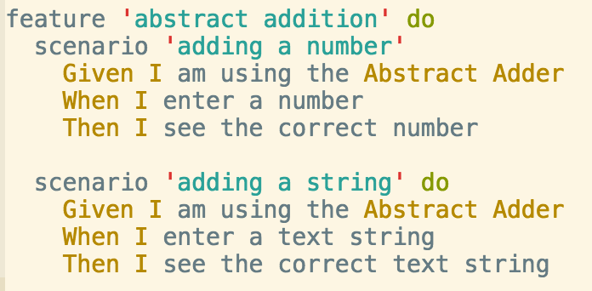
Function tests…
Applying the Rules – Passes Tests

Slide 29
How we took advantage of these
Applying the Rules – Passes Tests
We have numerous unit tests that serve multiple purposes:
They tell us our code works
First line of defense!
The help us understand what our code does and how to use it
The identify the limitations of our current design

Slide 30
How we took advantage of these
Applying the Rules – Passes Tests
We have numerous unit tests that serve multiple purposes:
They tell us our code works
First line of defense!
The help us understand what our code does and how to use it
The identify the limitations of our current design

Slide 31
They tell us our code works
Applying the Rules – Passes Tests
We have numerous unit tests that serve multiple purposes:
They tell us our code works
First line of defense!
The help us understand what our code does and how to use it
The identify the limitations of our current design

Slide 32
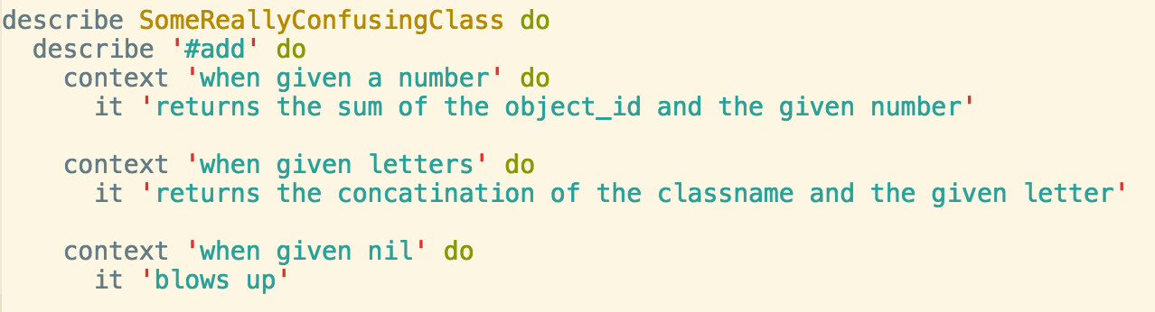
For example…
Applying the Rules – Passes Tests
If we break #add, we’ll know right away
Easy to see how the method is expected to be used
Easy to see the current design does not handle nil input

